Slide 1
Writing a Good Project Proposal.
A personal perspective.
Professor Chris Bowen, C.R.Bowen@bath.ac.uk.
Centre of Integrated Materials, Processes and Structures (IMPS)
Department of Mechanical Engineering, University of Bath, United Kingdom

Slide 2
Successful Proposal Development
Before you start: Read to Assessment / Call Criteria
Easy to just get interested in the research and assume reviewer will assess only research idea
Some applications require a training plan, which is equally important e.g. MSCA, Newton.
Industry or host input sometimes required – needs to be done in time.
If a specific call, make sure your idea fits, if not a good fit you are already on a back foot
Example: EPSRC Assessment criteria (score out of 6)
“For most research grant opportunities, the following high level UKRI criteria will form the basis of assessment:”
Vision
Approach/methodology
Applicant and team capability to deliver
Resources and cost justification
Ethics and responsible research innovation (RRI)

Slide 3
Successful Proposal Development
General process
Vision, or aims
Background, current state of art
Objectives and how you will go beyond the state of the art
Workplan and Work packages
  Deliverables
  Milestones
Risks
Workplan
Budget / justification of resources
These are not separate sections – they need for be presented as a coherent/interlinked plan.
Take some serious thought how this all fits together.
If you are doing this late, you are more likely to treat as separate sections/questions.

Slide 4
Successful Proposal Development
1. Vision or aim(s), sometimes ‘abstract’
Reviewers will read first and use this as a basis to understand (and rate) the proposal.
Important to get the reader excited at this stage.
Ensure its understandable to a wide audience.
Clear and simple message of the research – clarity is always key, not complexity
Have this upfront, avoid having a long “Background” and gradual build up to vision on Page 2.
- What is the new research?
- How is it new and exciting?
- Why does it need to be done now ? [Avoid just saying ‘urgent need’]
- What will be the outcome or impact to society, economy?
- For fellowship, why are you the best person to do this (why me), and/or your host (why at X).

Slide 5
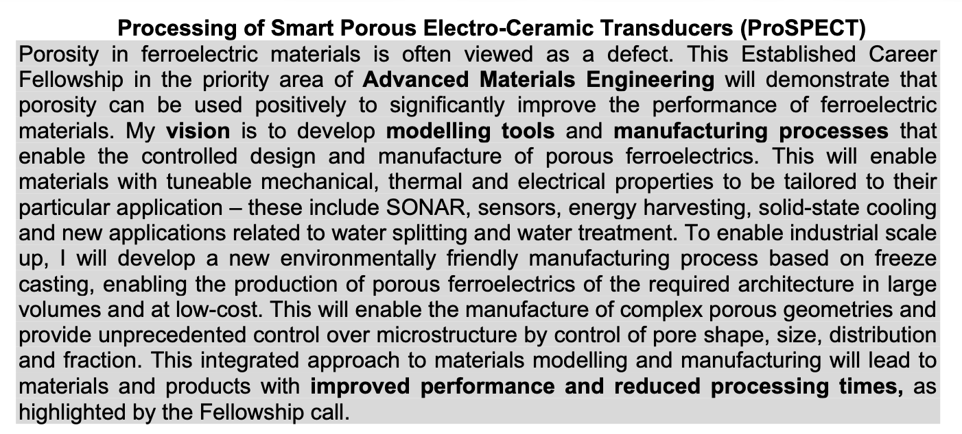
Example ‘Vision’

Slide 6
Successful Proposal Development
Research Context – ‘Background’
Global Context and "Big Picture”, the overarching challenge
Specific Gap: Identify exactly what is missing or failing in current technology. The "problem"
Summarise the most relevant previous research to demonstrate understanding current "state of the art"
The Rationale (The "Why Now?"): Explain why this research is urgent or timely. Mention recent breakthroughs in materials or changes in policy that make your project possible today.
Theoretical Framework: Briefly outline the engineering principles or scientific theories your project relies
End background clearly stating how your specific proposal will fill the gap you just identified.

Slide 7
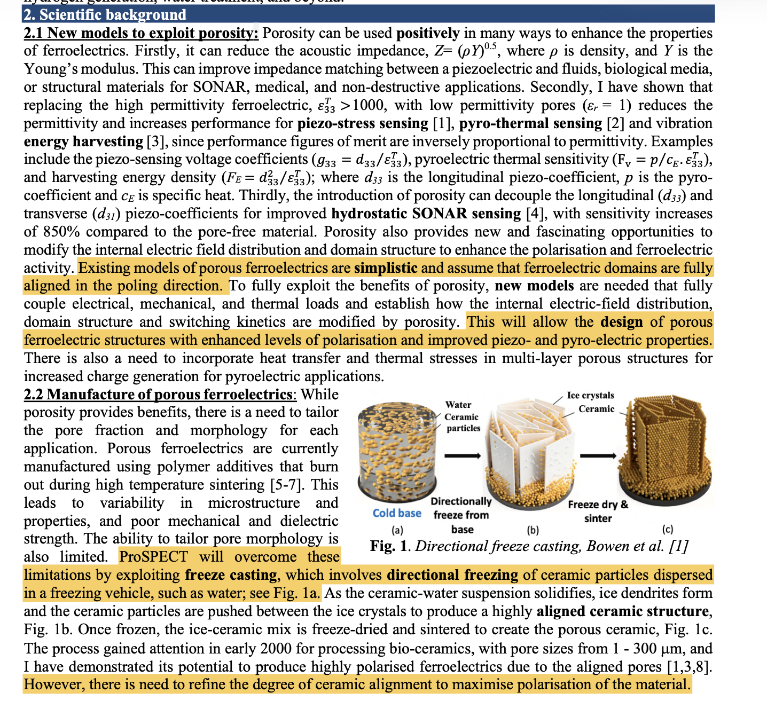
Research Context – ‘Background’

Slide 8
Research Context – ‘Background’

Slide 9
Successful Proposal Development
Research Objectives
Outline clear Objectives which:
- help meet the project “vision” or “aim”
- ideally be tangible and measurable
- objective should map onto the relevant work packages.
The objective of this project (O1 to O4) are to:
O1. To develop modelling tools…
O2. To create new methods to manufacture….
O3. To explore..…
O4. To demonstrate…
Use ”O’ to help differentiate when having multiple places in application 1., 2, 3. etc.…e.g. for Aims (A1..), WPs (WP1…), Risks (R1…)

Slide 10
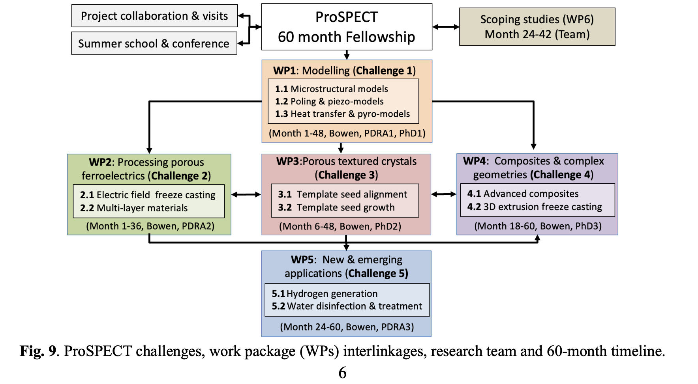
Develop project work packages (WPs) to formulate coherent plan
These help deliver objectives:
Provide clear outline of Work packages (WPs), and their linkages.
This is often placed at end of Work Package descriptions. “Fig, 9 shows the WPs.”
Personally, I think it is easier to show this at the start of WP description, BEFORE you describe them.
Do this maybe before writing, not at end.

Slide 11
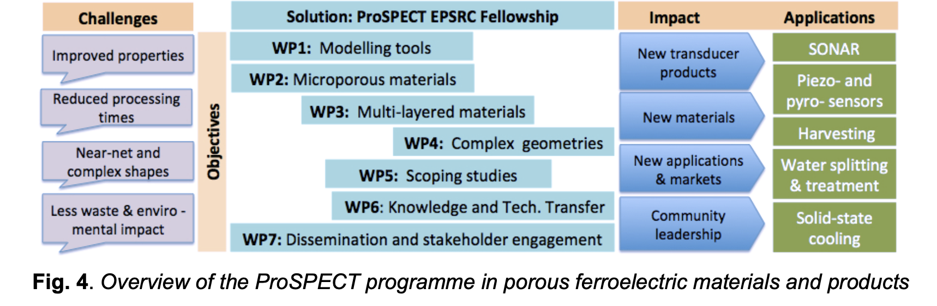
Diagram of Project – Develop early, to formulate coherent plan
Another approach - this outlines Challenges, WPs, and Outcomes

Slide 12
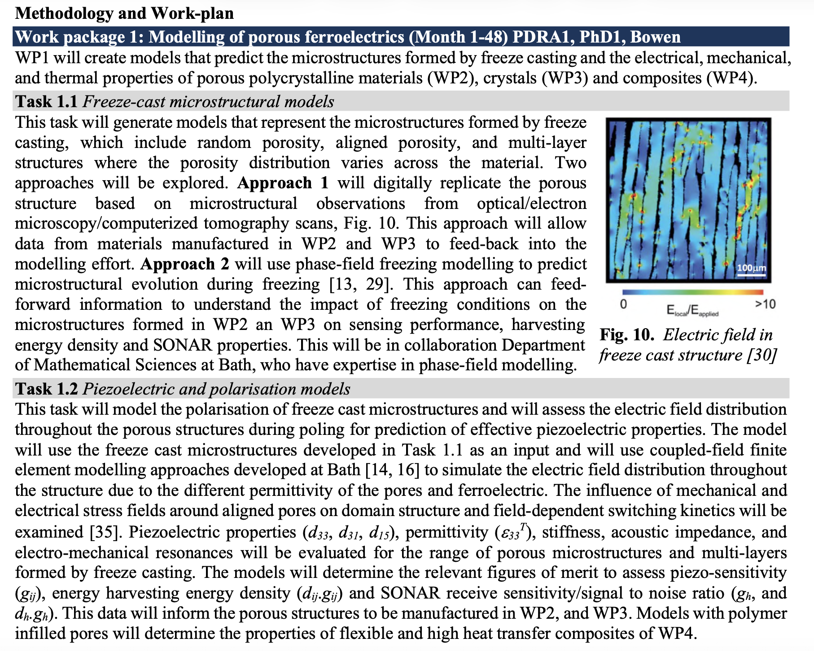
Work packages (the WPs)
Outline the WP, and linkage to other WPs.
These links often minimized to “save space” and add detail to tasks, but message can be lost.
Include responsible members and duration in title. Yes - there is a workplan later, but reader rarely flicking between the two, or reading ahead
Important to outline Tasks in WP.
Here Approach 1 and 2 as form of risk mitigation (later).
Image (Fig 10.) from Bath work – shows leader, ideally “Bowen et al..”

Slide 13
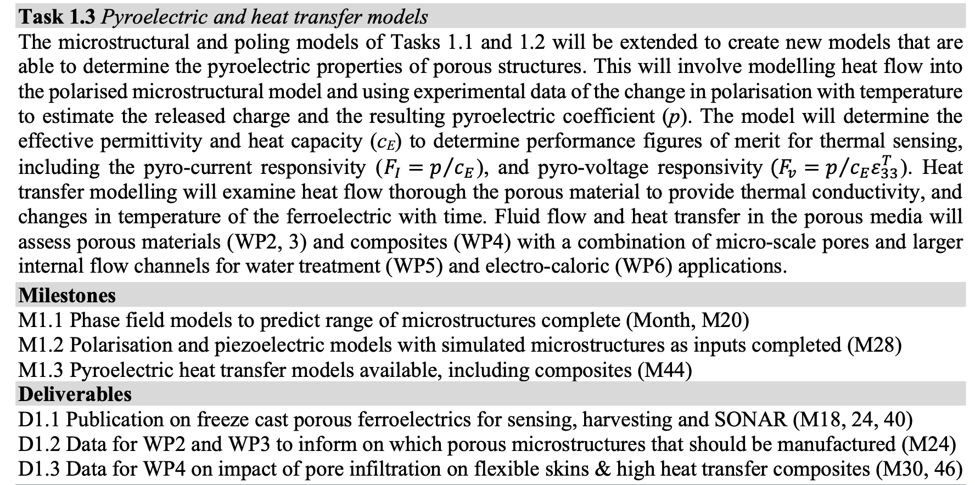
Work packages (the WPs)
Here list milestones (progression points) and deliverables (outcomes)
Dates and and how they relate to other WPs. also provided (and link to workplan diagram)

Slide 14
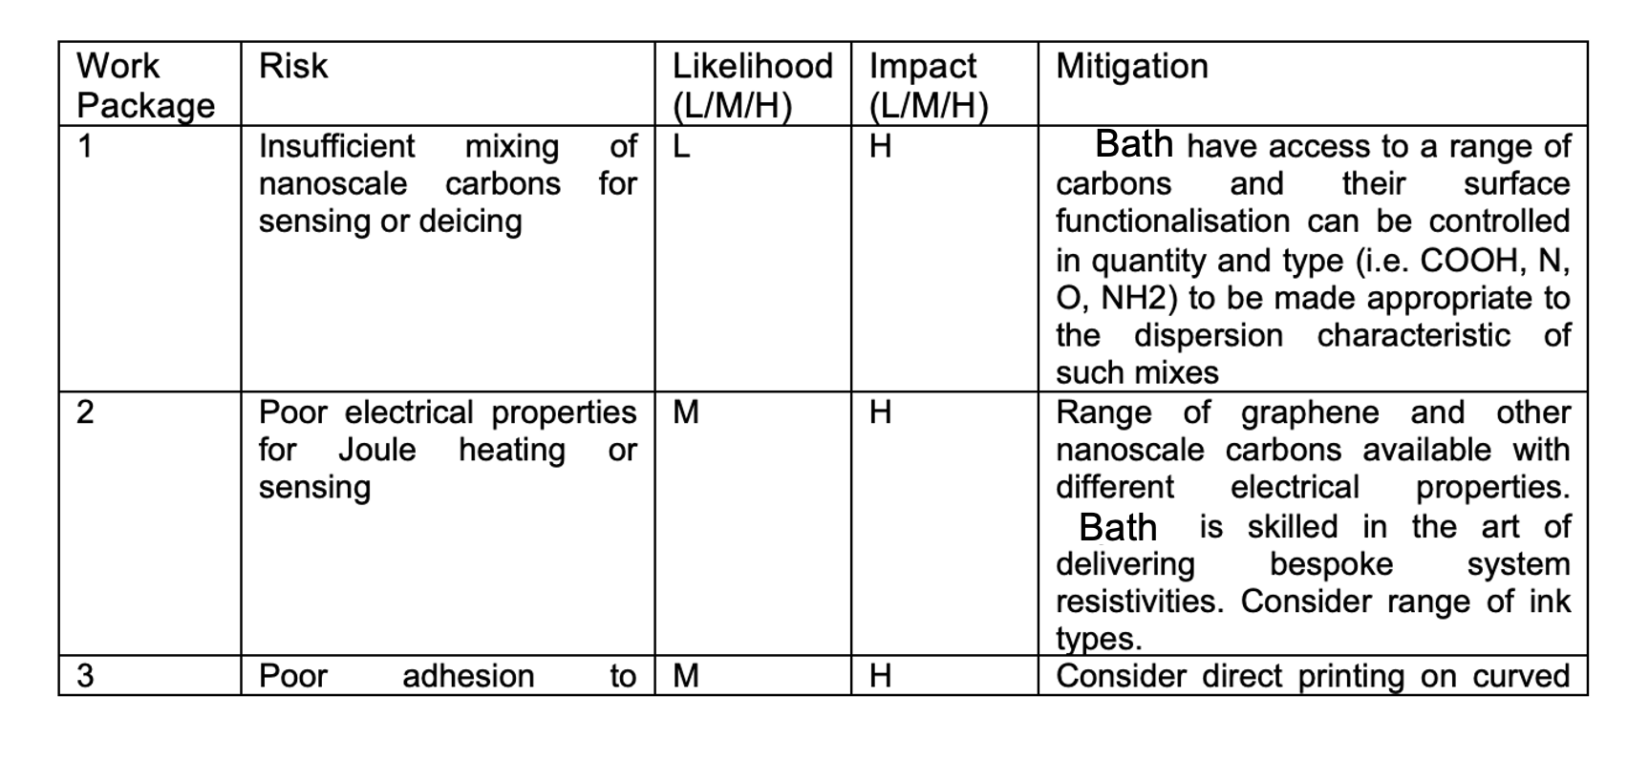
Risk & Mitigation
Outline risks that may jeopardise project progress.
Detail the likelihood of risk, without mitigation actions, as Low/Med/High.
Detail the impact on Time/Cost/Technical/Contractual/Resource if risk occurs as Low/Med/High
Describe mitigation actions put into place to avoid risk

Slide 15
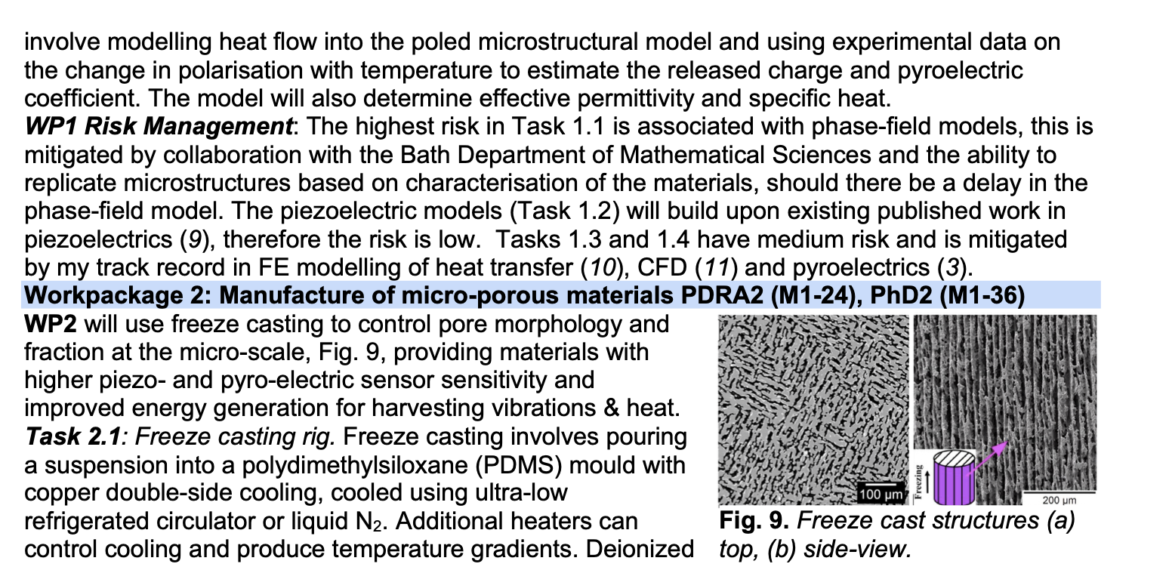
Risk & Mitigation
Other option is to summarise risks/mitigation at
end of WP.
Again, risks sometimes removed to add space for technical content in WPs. Avoid.

Slide 16
Risk & Mitigation (embed in project)
Here WP3 is high risk, but WP4 later can use WP2 materials if delayed or does not work. So, the whole project in not built on a ‘house of cards’.

Slide 17
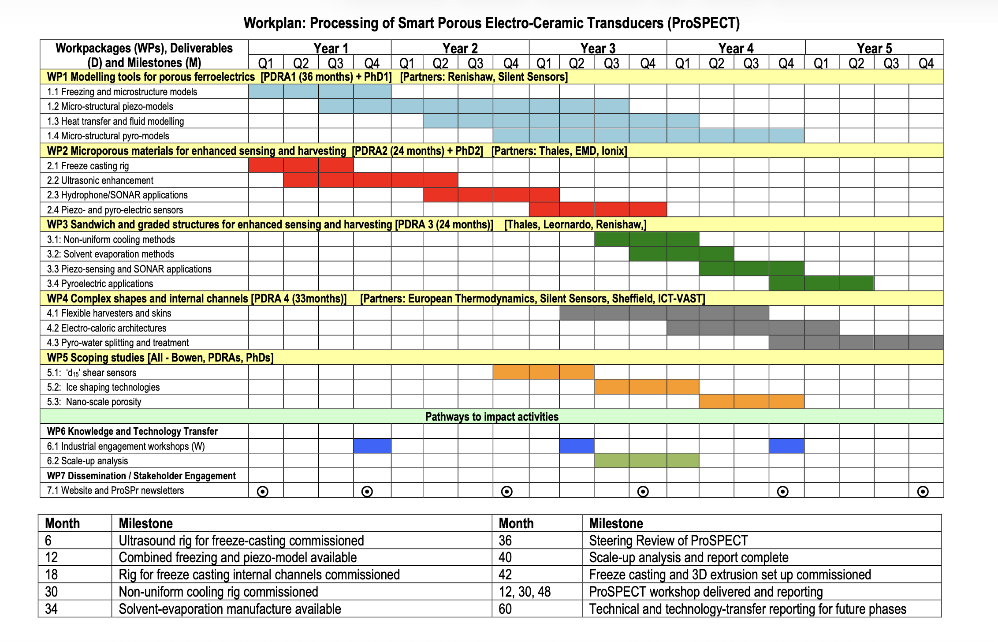
Diagram of Project – Do this early to plan.

Slide 18
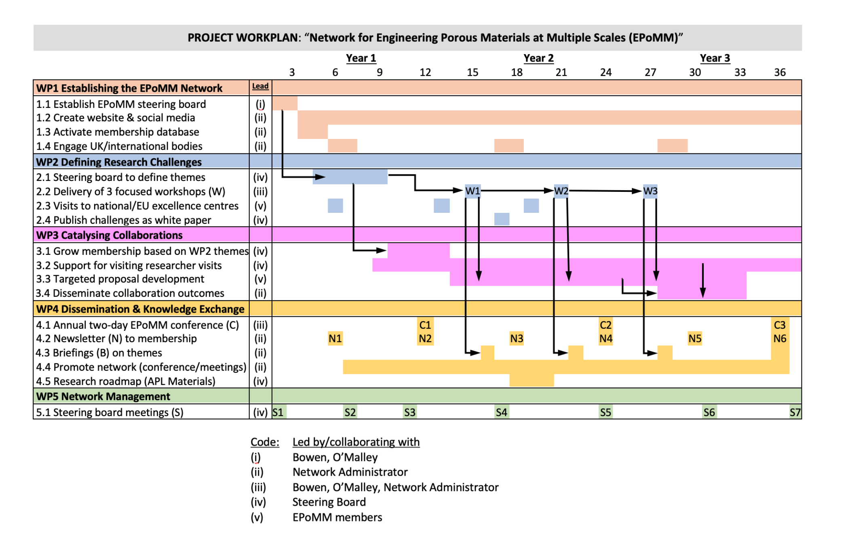
Diagram of Project – Do this early to plan.
Avoid months
where many WPs are
active.
e.g. if there is one researcher, but 4 WPs/8 tasks active at same time.
.

Slide 19
Successful Proposal Development
Letters of support or supporting statements from host
Some research applications need letters of support from industrial or academic collaborators; or a host supervisor (Fellowship).
Look at assessment criteria – e.g. if a training element in needed for visiting fellowship, a clear statement of training is far better than generic statements.
Ensure letter is ”Personalised” with respect to company, academic or host. See it is an opportunity to “add value” to your arguments, not to just confirm your idea is good.
You might need to draft to industry or busy host – if so, it still needs to be personalized by collaborator/host.
Ensure not just a summary of project and this it is an “interesting project” - this annoys reviewer as they have just read the same thing, and you are asking to read it all again.
For multiple letters ensure they different – again generic letters add no value and can even reduce score. They are read by assessors.

Slide 20

Budget and Justification of Resources (JoR)
University processes often need budget and ethics approval - do not leave to last minute. Know the university timelines.
As with the Letters of Support, avoid generic statements.
Example: ”attend two conferences each year” – other applicants will name the conferences and state their relevance to the project. The JoR is a chance to add detail, it is not a last-minute chore.
Likewise, detail on consumable items can be used to provide additional detail where you have no space in WP, or outline two types of consumable (and linked to risk)

Slide 21
Other tips/myths.

Slide 22
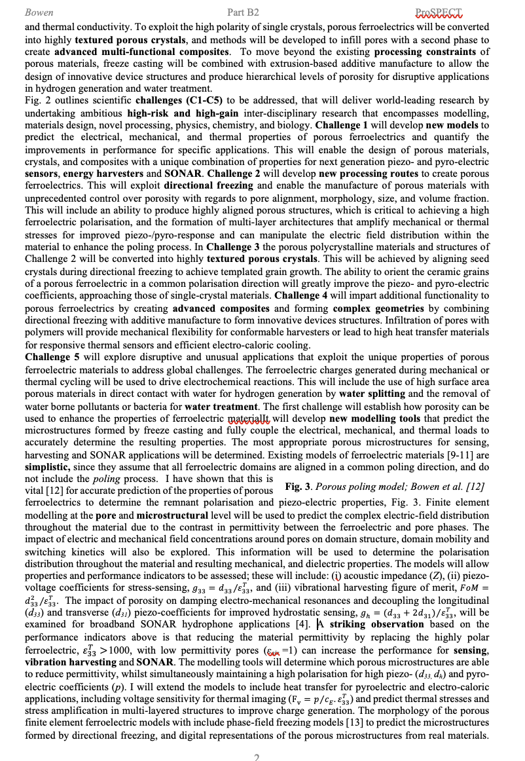
Avoid ”Wall of Text” – Break up text
Avoid dense text.

Slide 23
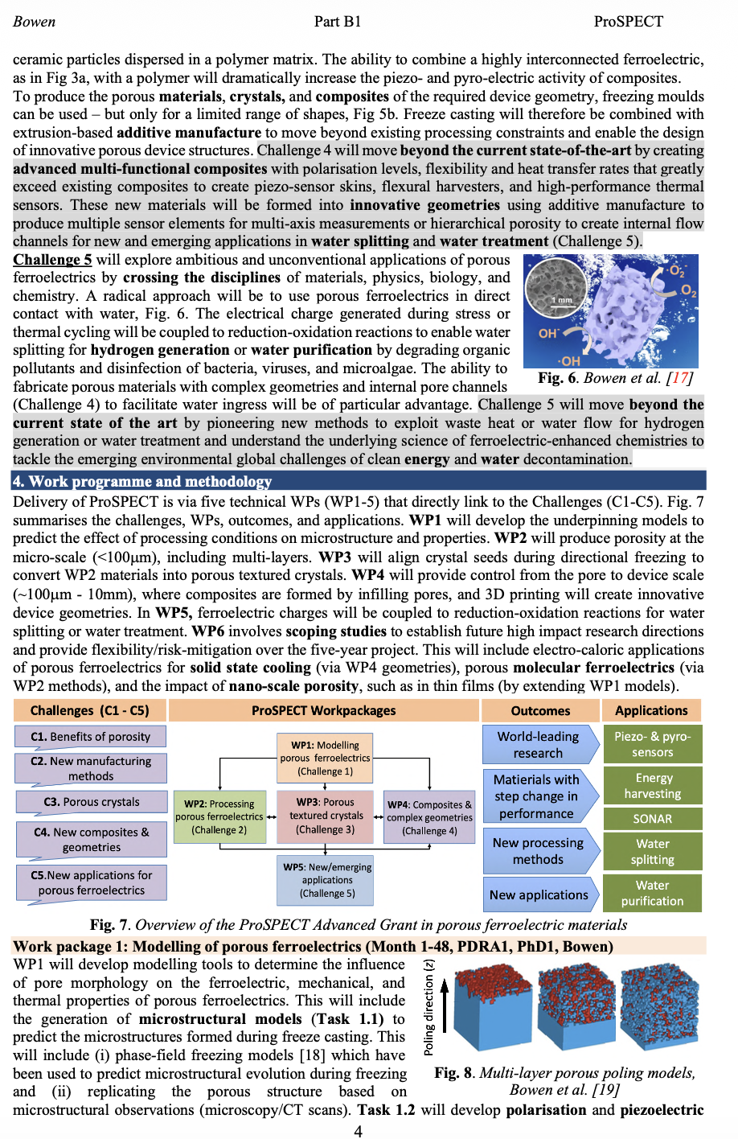
Avoid ”Wall of Text” – Break up text
Avoid dense text.
Break up into sections/images.

Slide 24
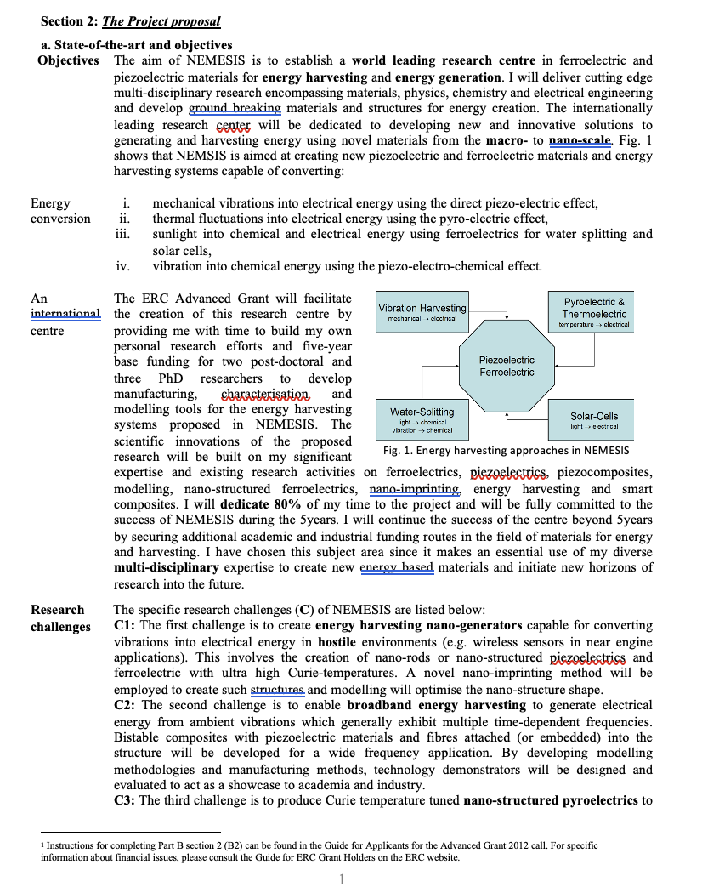
Avoid ”Wall of Text” – Break up text
Column/table format, left column matches criteria.
Avoid dense text.
Break up into sections/images.

Slide 25

Avoid overuse of Acronyms, e.g. three letter acronyms (TLAs):
Reviewer or panel members often have to examine more that one proposal, and/or are simply busy.
Do not think you are special and your proposal is delivered on a silver platter to a fanfare.
It can be difficult for reviewer to remember all of the acronyms, especially if it not a common acronym and reviewer is assessing many proposals, each with many acronyms.
Not a problem to redefine acronym (e.g. when in title or figure heading) to help reader.
Acronyms (TLAs)

Slide 26

Avoid adding in “pet activities” - something you always wanted to try.
You may have a “side-project” that you always wanted to really explore.
The idea does not really fit to the vision or objectives for this proposal, but you really want to try it, nevertheless.
So, you think, “maybe I will just slip it into a task or work package, no one will notice”.
Avoid – a reviewer will notice this straight away and again distract form trying to make a linkage of Vision, Objectives and Work packages.
Remember, clarity is key.

Slide 27
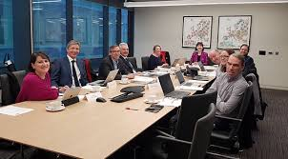
Myths: “It is all random” in terms of getting you application funded
My experience on panels (in a range of countries) is:
There are a small number of truly amazing applications, which will consume some of the available budget, but not all.
There are a small number of poor applications, which are simply not going to get funded.
The vast majority of applications are strong and fundable, but clearly not all can be funded.
Here, the little things can therefore make the difference or whether you are in the fundable zone.

Slide 28
Final points

Slide 29
R4Ri – Resume for research and innovation
https://www.ukri.org/apply-for-funding/how-to-apply/resume-for-research-and-innovation-r4ri-guidance/
Moving away from ”lists” - papers, presentations, patents, funding etc.
Now a narrative and focus on best aspects.
You can use metrics, eg. citations, but you need to provide the “context” e.g. citation or impact factor not really a direct marker of quality, but citations can be indicator of your “reach”.
R4Ri can be thought of four modules, like an onion
Module 1 – Contributions to the generation of new ideas, tools, methodologies or knowledge
- research outputs, new knowledge, datasets, patents, funding, awards
Module 2 – Contributions to the development of others and maintenance of effective working relationships
- supervision, creating networks, teaching/tutoring, training [maybe these at your institution]
Module 3 – Contributions to the wider research and innovation community
- working across disciplines, institutions, countries, reviewing, professional bodies, open research
Module 4 – Contributions to broader research/innovation-users and audiences and towards wider societal benefit
- commericialisation, public engagement, knowledge exchange

Slide 30
Responsible Research and Innovation/ Trusted Research
“ Responsible research and innovation is a process that seeks to promote creativity and opportunities for science and innovation that are socially desirable and undertaken in the public interest.”
Anticipate, reflect, engage, act (AREA) framework; eg;
Anticipate Risks and Impacts: e.g. long-term systemic impacts of hydrogen, such as the environmental effects of hydrogen leakage on the upper atmosphere
Reflect: Instead of presenting hydrogen as a "perfect" fuel, the team reflects on the transparency of their data.
Engage: Stakeholder Engagement involving local community for public perception
Act: Responsiveness to New Evidence and allow project to pivot as new data emerges.

Slide 31

Panel Interviews
Practice (multiple times) - mock interviews with colleagues and non-colleagues, ideally those that have done before.
Try and prepare for questions - read the research assessment criteria again, speak to others.
Prepare, yes, but also be prepared for any question. Don’t have a strict script.
Simple slides, again. Often the panel spans over multiple days or many interviews, complex slides will NOT be helpful.

Slide 32
Conclusions
Summary
Know the research assessment criteria, read them again and again to make sure keep on track.
Develop a clear and well written/constructed proposal.
You are making a case for your research, not writing a story so no need start of with long background, then vision.
Realise this all takes time, thought and effort, prepare well in advance. This is your competition.
Get your peers to review and learn from successful proposals – but don’t just follow others blindly.
  What in new and exciting about the research? Why does does it need to be done now? What will be in impact/outcomes (academia, industry/economy, society)? Why are you the best person to do the research?
Develop a clear linkage and mapping between the Vision, Research Challenges/Questions, Objectives, Work Packages and Deliverables/outcomes; even budget/justification of resources.
The big things matter, namely the exciting idea, the new research and impact, but so do the little things – this includes, clarity and interlinkage of project activities, presentation etc.

